Slide 1
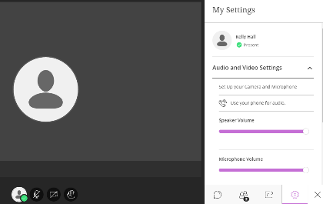
Audio and video set up
Step 1: Click on the purple tab
(bottom right)
Step 2: Set up camera and microphone settings
Open Collaborate Panel Icon at (bottom right) > My Settings icon (looks like a cog).
Click on Audio and Video Settings, then Set up your camera and microphone.
Preview your audio and camera.
Step 3: Set up speaker and microphone volume
My Settings icon.
Click on Audio and Video Settings and adjust your speaker and microphone volume.
My Settings Icon

Slide 2
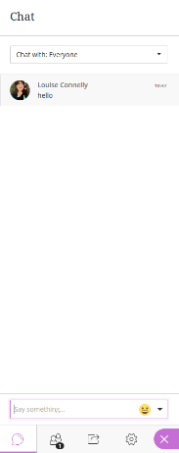

Accessing the chat feature
Click on the purple tab
(bottom right)
Click on the bubble icon:
Type here and hit ‘return/enter’ for it to show to the rest of the virtual room

Slide 3

Audio check
Can you hear the presenter talking?
Please raise your virtual hand if you can hear.

Slide 4



Etiquette
Text/Audio/Webcams: the lecturer or facilitator will advise about the format of the session.
During discussions, please use the raise your hand function and wait for the lecturer or facilitator to ask you to speak.
Mute your microphone unless it’s your turn to speak.
Why is my name displayed? Your name is displayed to the lecturer/facilitator/students/you. This helps to keep the learning space secure, support academic community and student engagement, and run the session effectively.
Do I have to turn my video on? No, you don’t have to. However, turning your video on when you speak can make it easier for us to get to know each other and work together.
Identity
This class may be recorded
The lecturer/facilitator will tell you if the session is being recorded or not.
The lecturer/facilitator will tell you whenever recording starts and stops.
Further information about recording is on the next slide.
DEU-2020v1.5

Slide 5
Recording (if applicable)
This session will now be recorded. Any further information that you provide during a session is optional and in doing so you give us consent to process this information.
Who can view the recording? Only the students and staff on this course (unless advised otherwise e.g. for future use). You must not share it further.
  To do so would breach University regulations, copyright law and, perhaps most importantly, the trust that’s required between us all to keep your learning environment safe.
Is the text chat recorded? Normally, yes. The lecturer or facilitator will tell you whether the chat is anonymous or identifiable.
DEU-2020v1.5

Slide 6
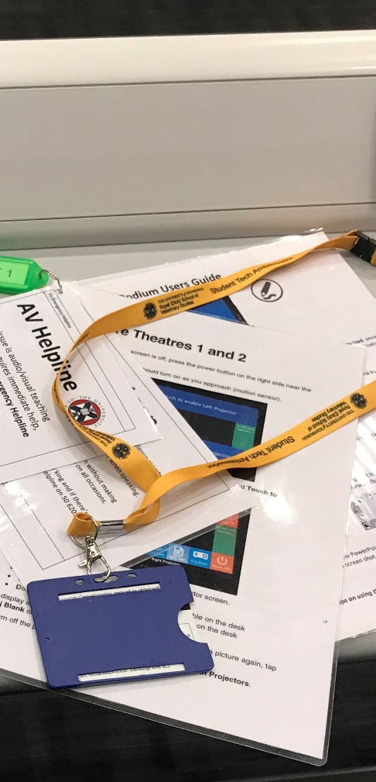
Undergrad Student Tech Ambassadors
Undergrad Student Tech Ambassadors may be available in this session to help lecturers with some technical issues during their presentation.
If a presenter would like assistance, they can call on a Tech Ambassador.
Tech Ambassadors – please send a private message to the lecturer to let them know you are available in the session.

